Slide 1
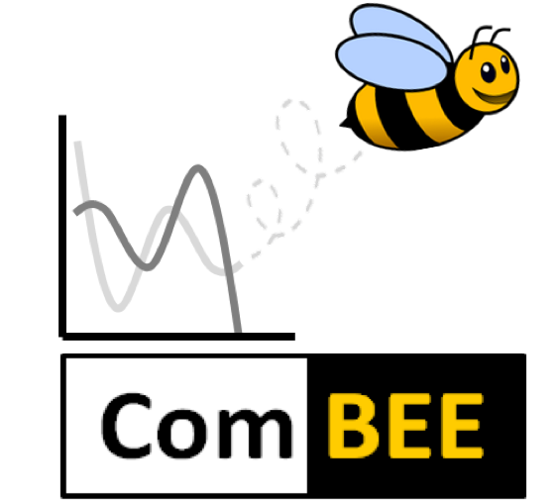

Integrating Computational Skills into the Biological Sciences through Peer-Led Study Groups
University of Wisconsin – Madison
Computational Biology, Ecology & Evolution (ComBEE) Group
Elizabeth McDaniel
@lizilla93

Slide 2
Computation in Biology
Biology is (becoming) very data heavy
Sequencing, ‘omics approaches
Most biologists aren’t trained in computational/programming skills (yet), but most will eventually need these skills
PI’s/labmates may not be able to help with current techniques
Coursework can give students a leg up, but lacks continuous support or area specialization

Slide 3
ComBEE
Computational Biology, Ecology, and Evolution
Peer-led, student organized group
Bi-weekly R and python study groups
Monthly seminars on theoretical ecology & evolution topics, or a computational tool a lab developed
https://combee-uw-madison.github.io
@ComBEE_UW

Slide 4
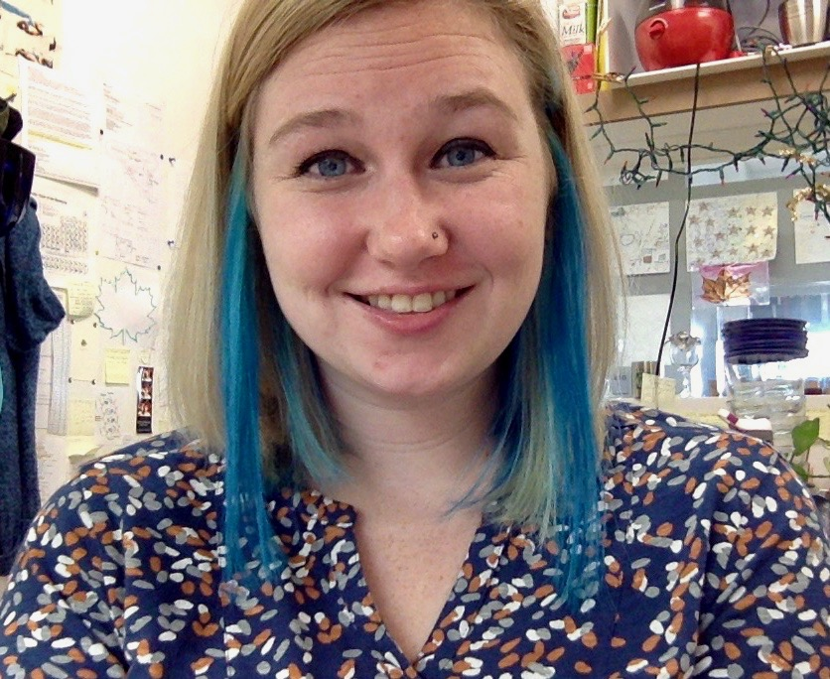
ComBEE Leadership
Co-Chairs
Kirsten Gotting & Elizabeth McDaniel
Scheduling events, finding study group leaders, organizing workshops

Slide 5
R/python Study Groups
Groups meet on alternate weeks
Generally an informal discussion of topics, based on group interests
Each study group has a Github repository through our Github organization, through which our website is also hosted
https://github.com/ComBEE-UW-Madison

Slide 6
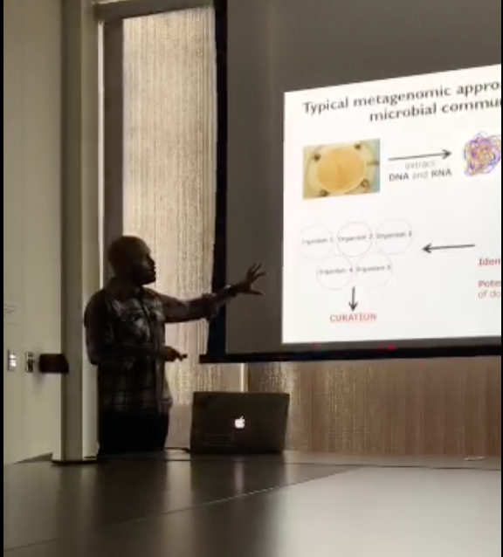
Monthly Seminars
Informal seminars featuring a professor or postdoc
Talks on theoretical ecology & evolution or demonstrations of computational tools/workflows

Slide 7
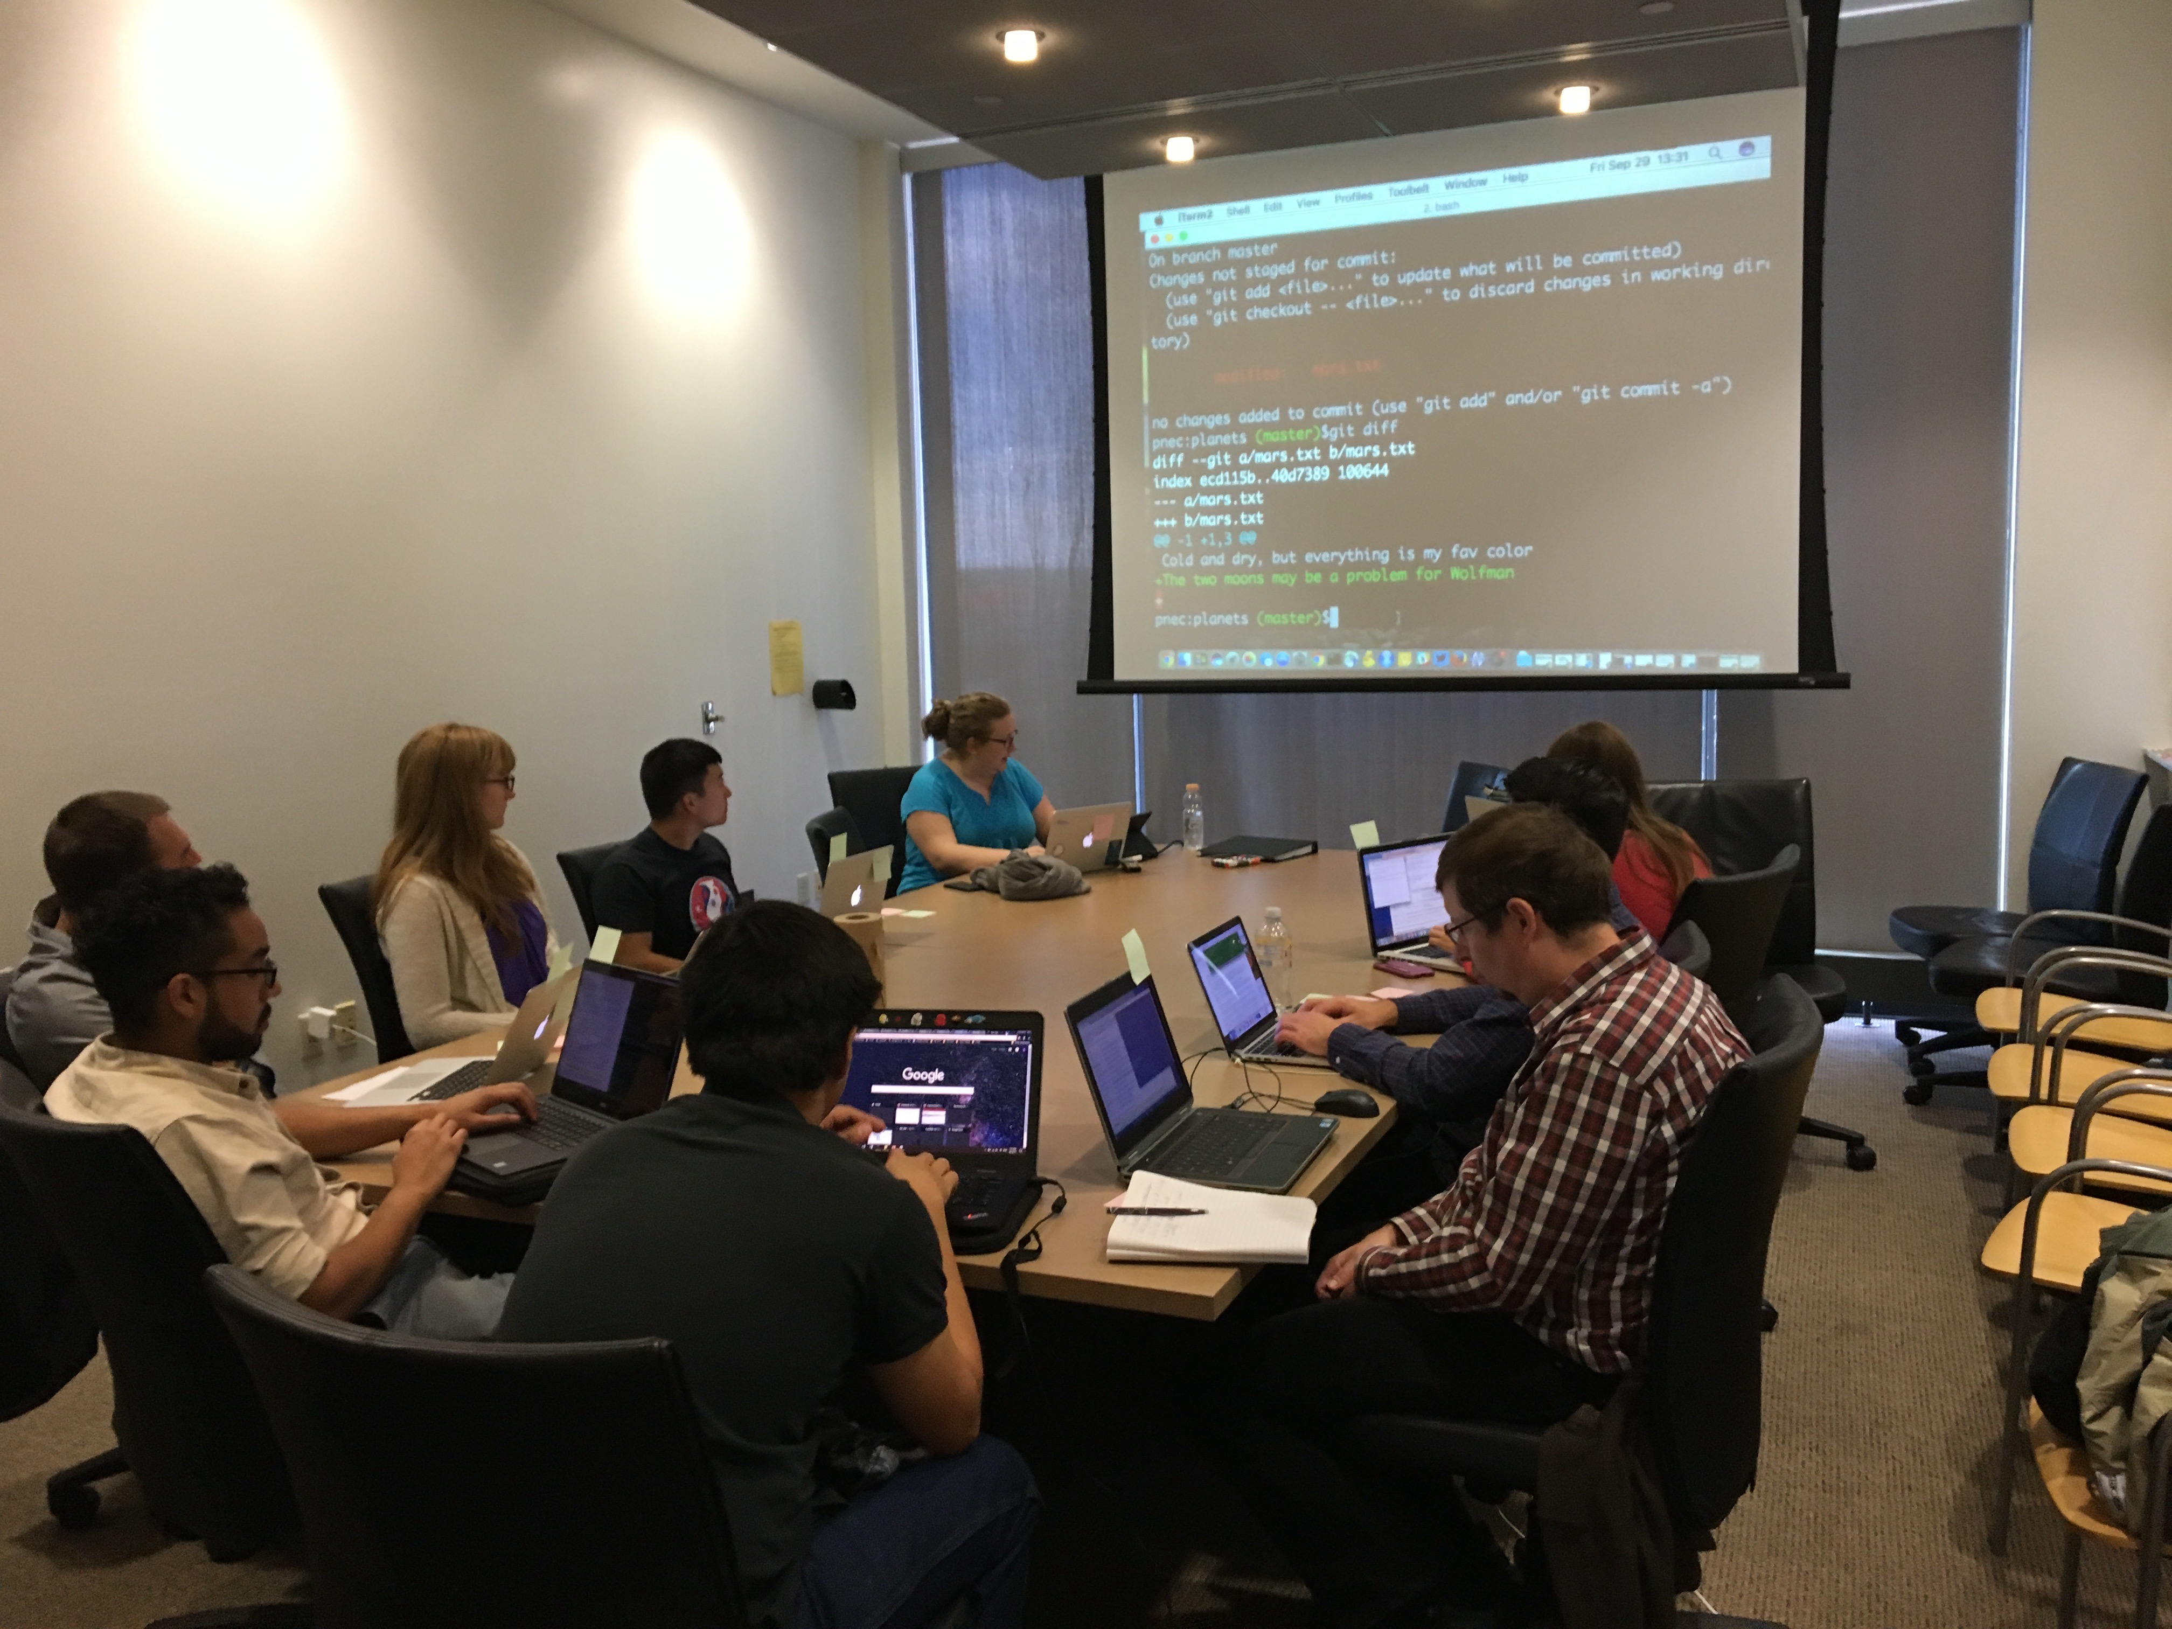
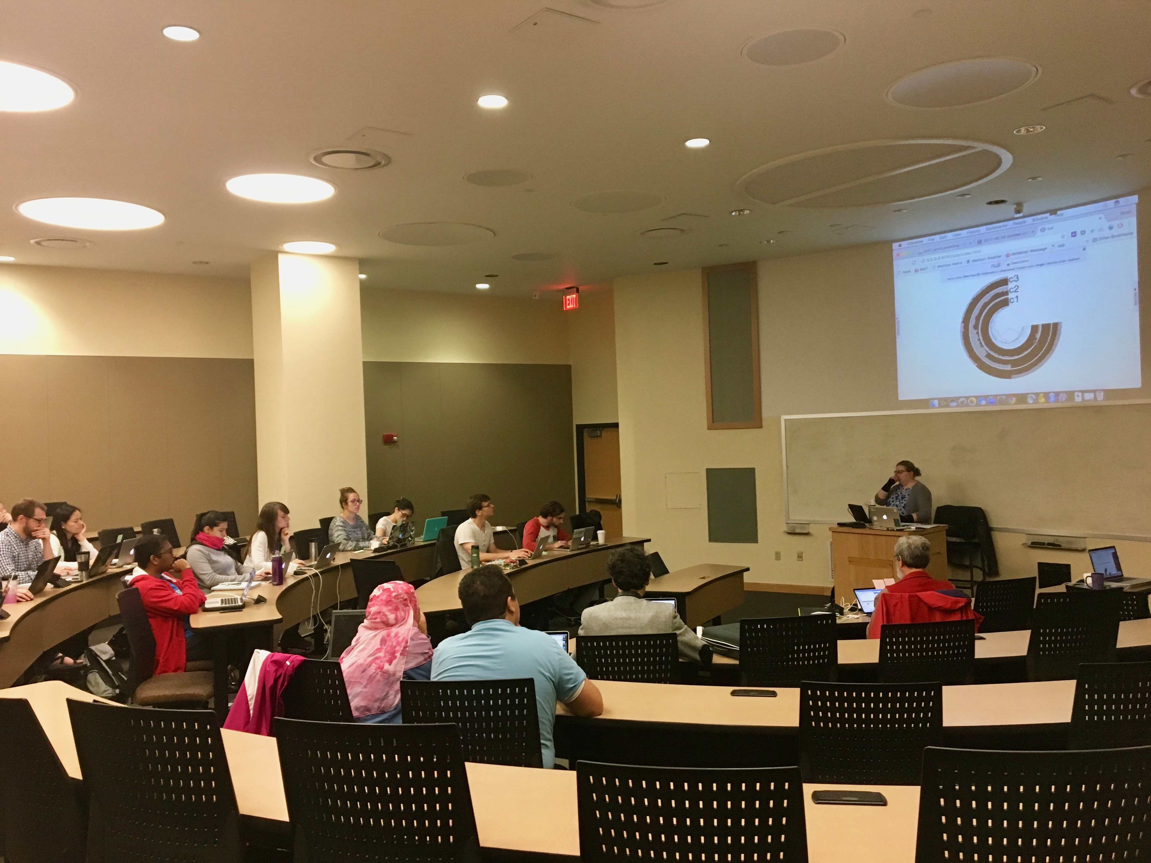
Workshops
Github/Github-pages to create a personal website
Anvi’o – an analysis and visualization platform for ‘omics data

Slide 8
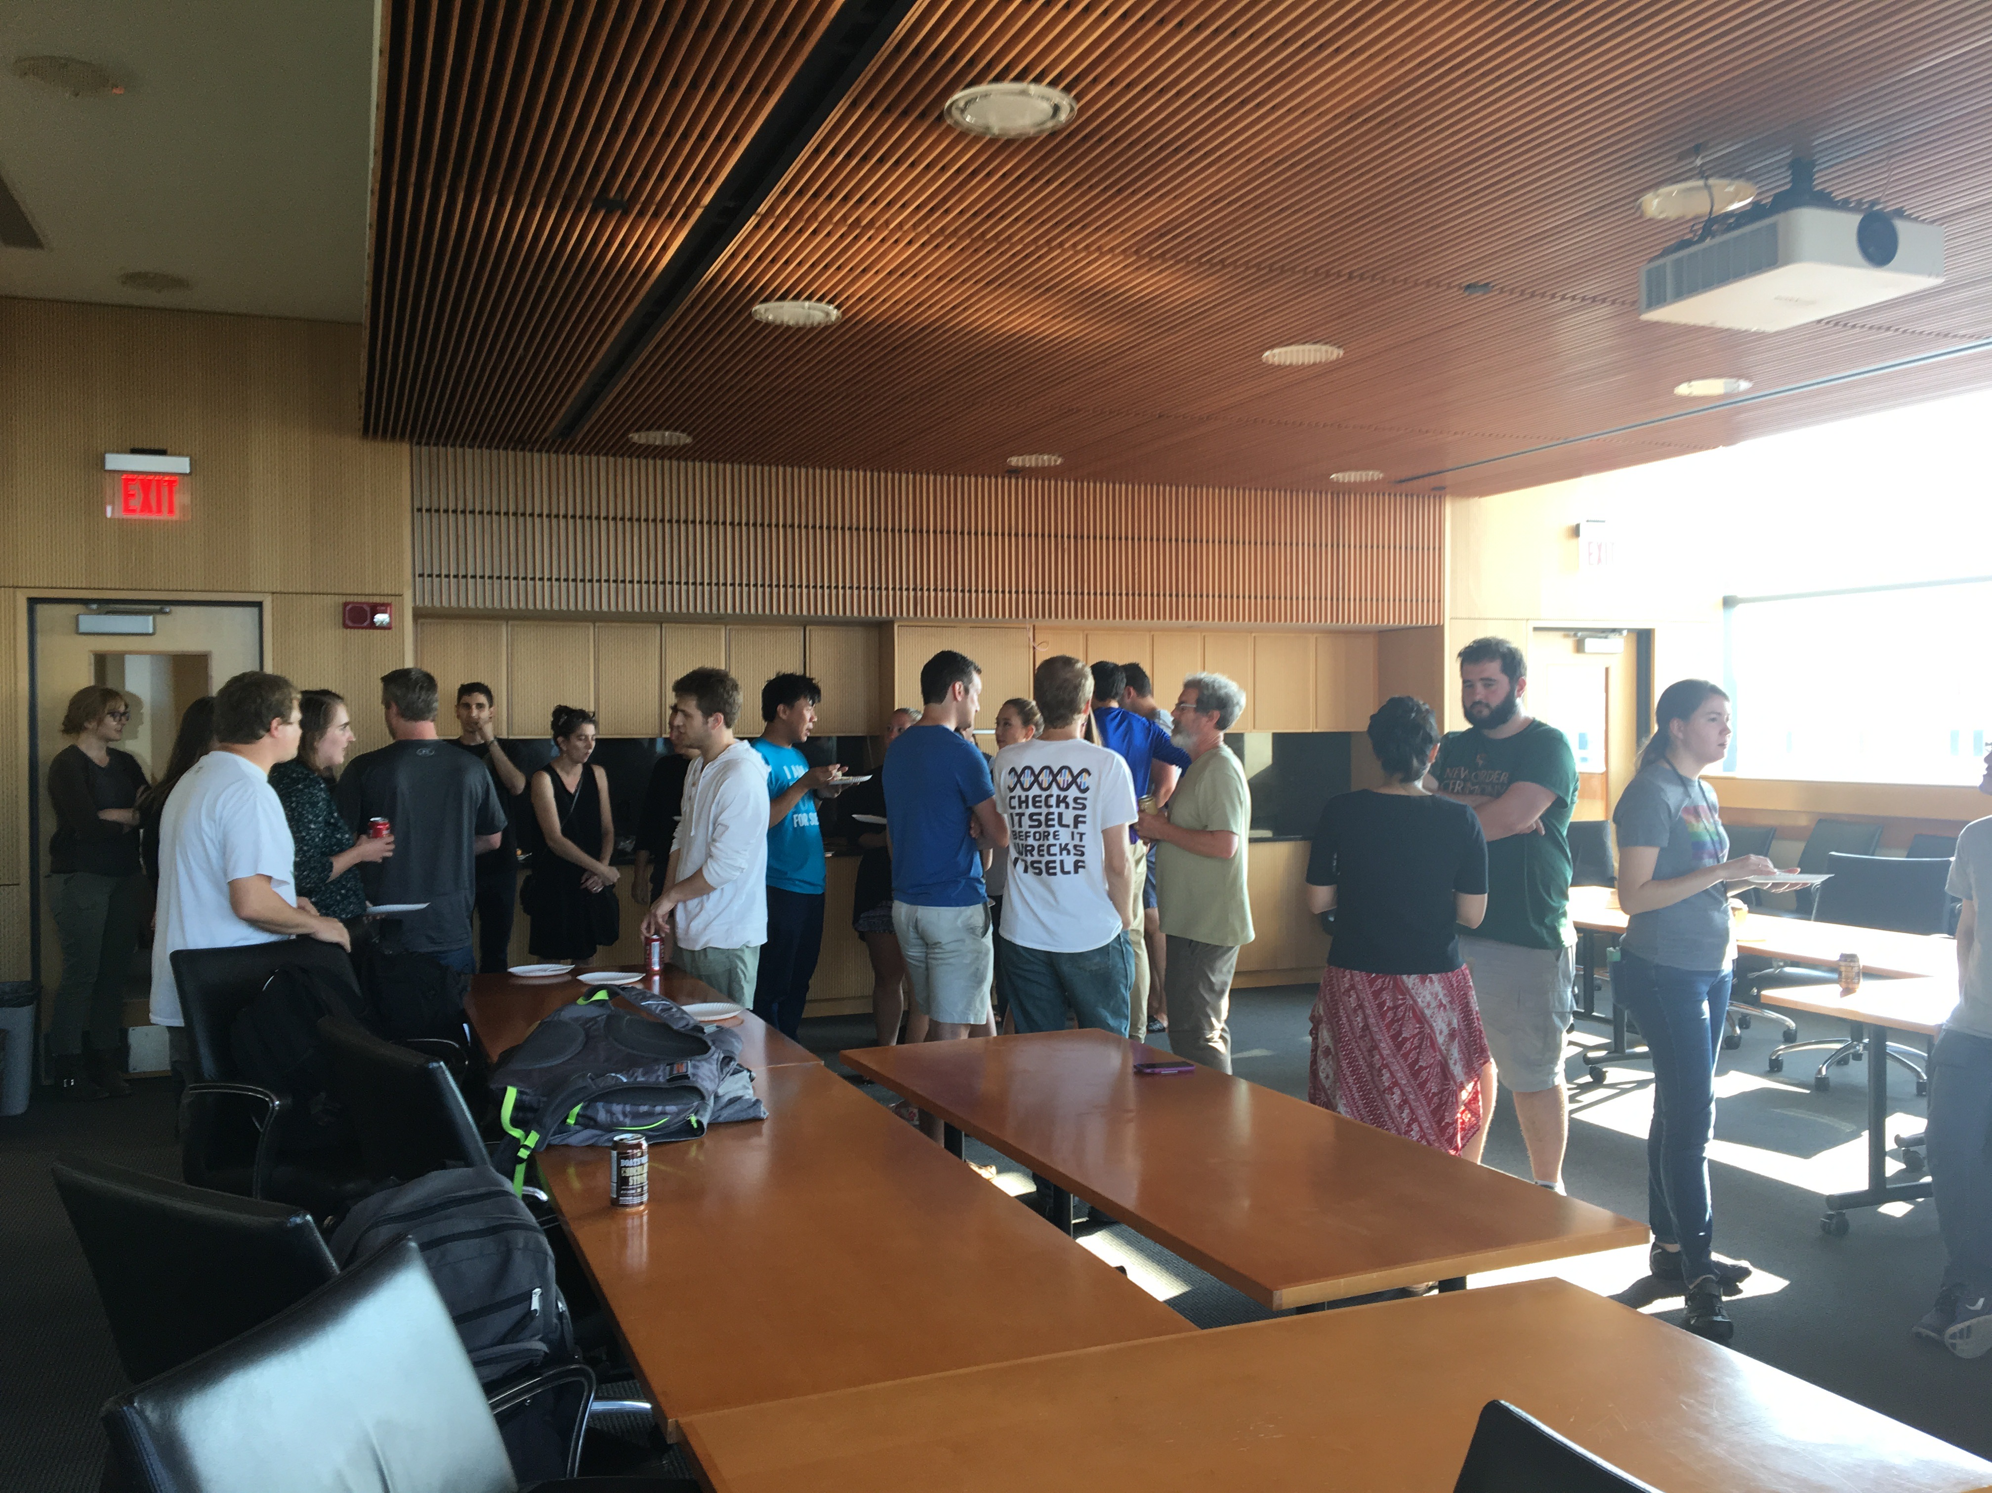
Social Events
Socials at the beginning of each semester to re-connect with researchers across campus and recruit newcomers interested in computation
No funding, co-chairs provide snacks/beverages on our own

Slide 9


Computational Resources on Campus
Joint organizations through the UW Biotech Center and the Wisconsin Institute for Discovery to 1) Better tackle projects with large amounts of data and 2) Connect researchers specifically interested in microbiome questions – human, host-associated, environmental, etc.
Coordinating ways to best bring resources (virtual servers, sequencing platforms) to the community in addition to teaching researchers computational and data analysis skills

Slide 10
Lessons Learned
Sending efficient and succinct emails
Communicating effectively with a co-chair, study group leaders
How to create an open and inclusive environment through study groups and workshops where individuals can come away with new skills
Accommodating to a range of computational skills in the same room, beginner to expert

Slide 11
Future Plans
Considering new languages to host study groups for (e.g. Julia, bash basics)
Summer workshops through the Microbiome and Data Science Hubs on campus
Metagenomic assembly
Comparative genomics & phylogenomics
Statistical analyses and data visualization

Slide 12
Questions?
Elizabeth McDaniel
emcdaniel@wisc.edu
@lizilla93
https://combee-uw-madison.github.io
@ComBEE_UW

